Slide 1
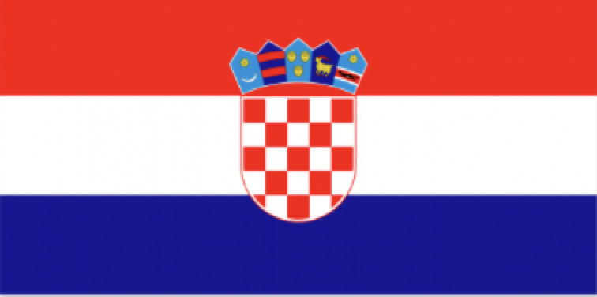
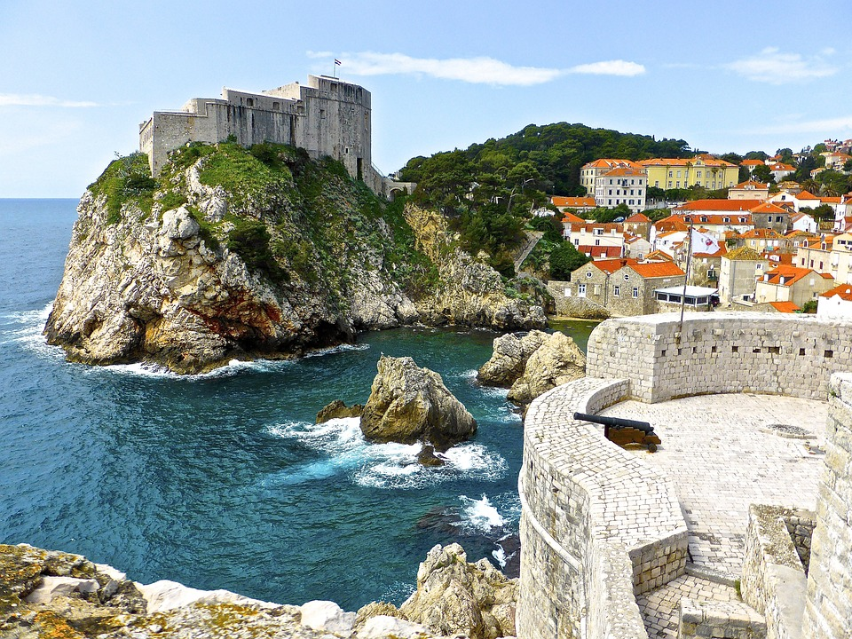
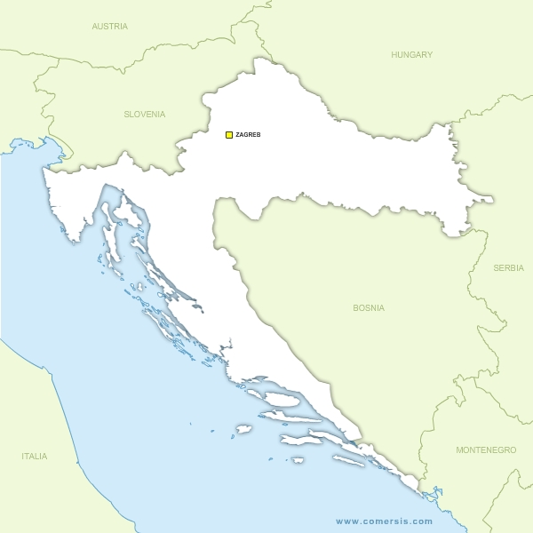
Euro Challenge
Croatia
An overview of Croatia’s economy
Croatia is a small country, but plays an important role in the economic and political stability of Southeast Europe.
Croatia is a developed country with high-income and ranks 40th in the Human Development Index. The government provides its citizens with free health care and free elementary and secondary education. According to the Gini coefficient, it ranks among the 20 countries with the lowest income inequality in the world.
Croatia’s road to globalization began as soon as the country gained independence in 1991. Croatia first joined the World Trade (WTO) in 2000, NATO in 2009, became a member of the European Union 2013. It joined the Eurozone and the Schengen Area on January 1st , 2023. The Kruna was replaced by the Euro.
The economy of Croatia is considered as a service based social market economy with the tertiary sector accounting for 70% of total gross domestic product (GDP). Tourism is a significant source of revenue, and comprises 19.6% of Croatia’s GDP. The beautiful coastlines and intriguing culture of the country lead to it ranking among the top 20 most popular tourist destinations in the world.
Croatia’s economy is very open to international trade. Nearly 65% of trade is conducted with other
countries in the European Union, while trade with its neighbors in southeastern Europe is also significant.
Croatia is working to become an energy powerhouse with its floating liquefied natural gas (LNG) regasification terminal on the island of Krk and its investments in green energy, particularly wind, solar and geothermal energy. The country owns the largest power plant with binary technology in Europe and began constructing a second plant in 2021.
During the COVID-19 pandemic, the Croatian IT industry grew significantly. Its digital economy increased by 16 percent on average annually from 2019 to 2021, and by 2030 its value could reach 15 percent of GDP, with the ICT sector the main driver of that growth.
Did you know . . . ?
Geography Croatia is located in the northwestern part of the Balkan Peninsula. It is a small yet geographically diverse crescent-shaped country. Its capital is Zagreb, located in the north.
History Croatia (Hrvatska) is an ancient nation, yet a very young nation state. It had to endure a thousand years of foreign meddling, subjugation, incursions, and outright wars before being recognized in 1991 as a distinct entity.
Culture Croatia represents a blend of four different cultural spheres. It has been a crossroad of influences from western culture and the east since the schism between the Western Roman Empire and the Byzantine Empire, and also from Central Europe and Mediterranean culture.
Fun Fact Croatia is a very sunny country. With more than 2715 hours of sunshine every year. Croatia receives more sunlight than Australia!

Slide 2
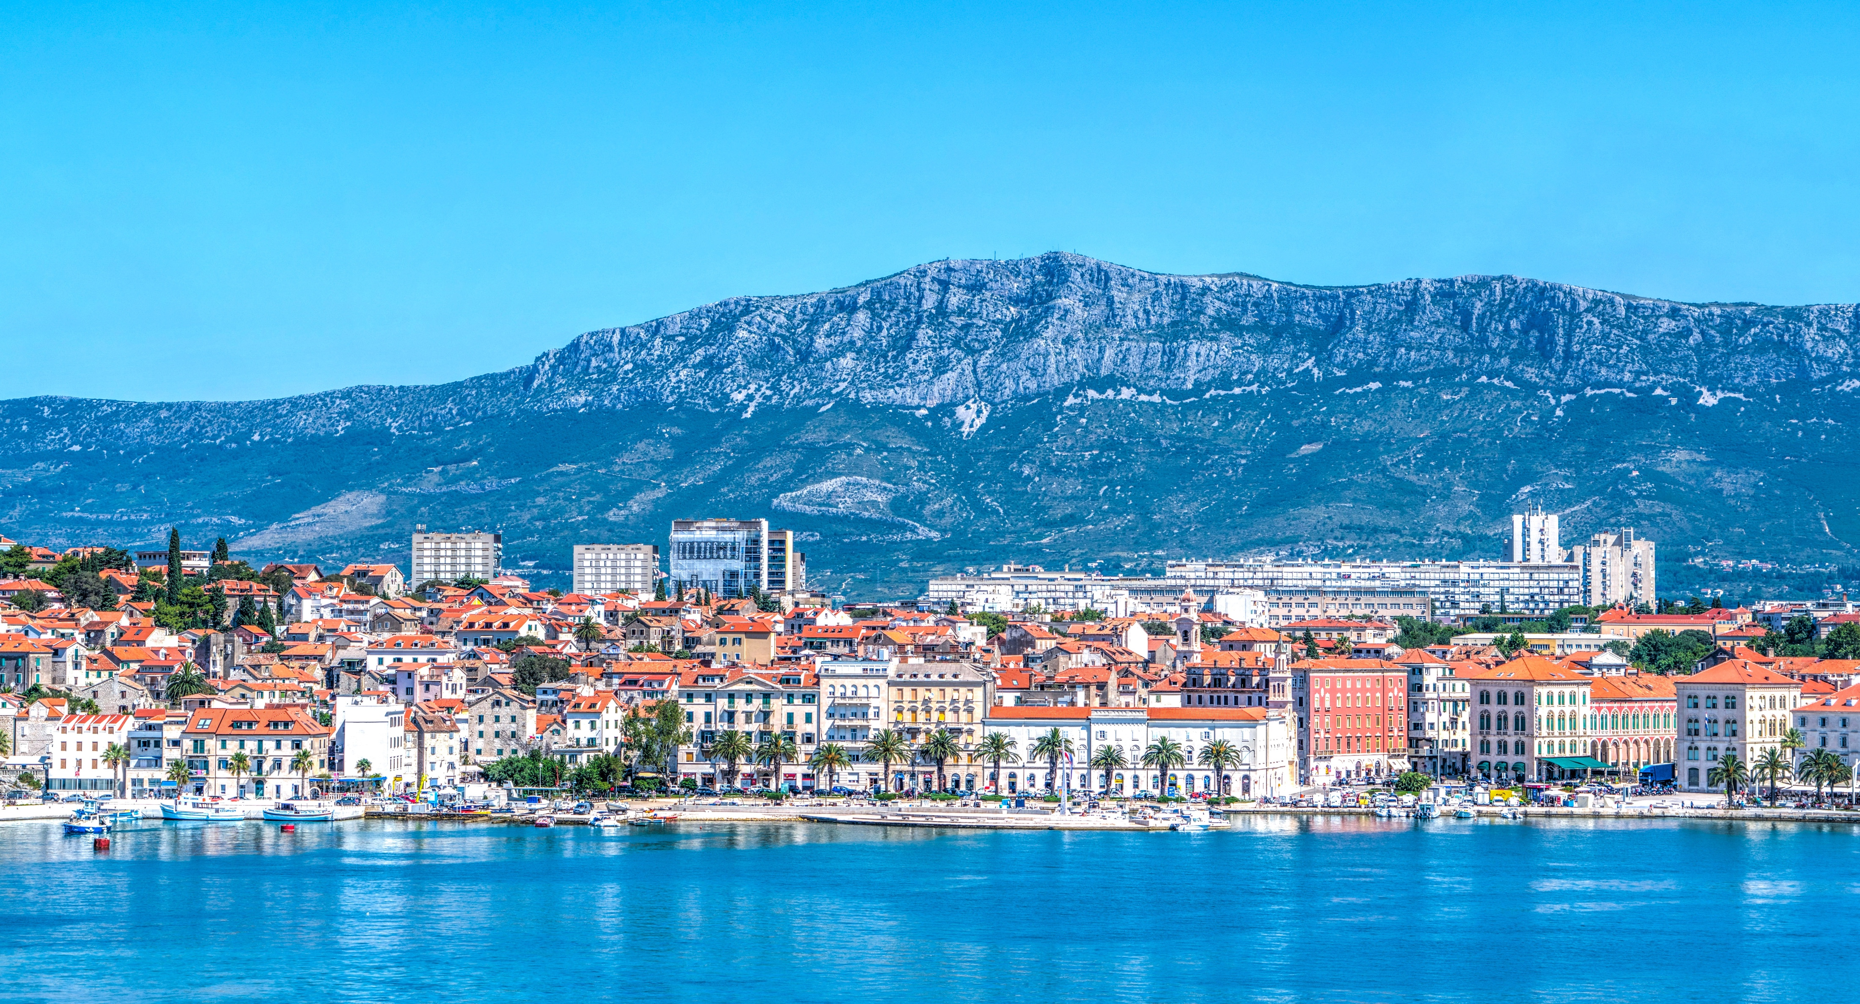
Euro Challenge
Croatia’s Economy – Key Facts
In 2022, Global GDP per capita was 11,893 EUR per capita. By comparison, 2022 GDP per capita in Croatia was EUR 14,660 per capita. This amounts to 2022 Croatian GDP being 66.94 billion EUR.
Croatia has excellent access to shipping routes because of its long coastline on the Adriatic. The major seaports of Rijeka, Zadar, Sibenik, Split, Ploce, and Dubrovnik link Europe, via the Suez Canal, with Asia and Australia.
In recent years, Croatia’s greenhouse gas emissions have declined modestly but its economy remains relatively emissions intensive. Raising living standards, while reducing emissions, will require an accelerated decoupling of emissions from economic activity.
In 2021, Croatia joined the list of countries with its own automobile industry, with Rimac Automobili’s Nevera commencing production. The company also took over Bugatti Automobiles in November 2021 and started building its new HQ in Zagreb.
On Friday, November 12, 2021, Fitch raised Croatia’s credit rating by one level, from ‘BBB-’ to ‘BBB’, Croatia’s highest credit rating in its history.
References
https://www.britannica.com/place/Croatia
https://data.worldbank.org/country/croatia?view=chart
https://www.worldbank.org/en/country/croatia/overview#3
https://www.imf.org/external/datamapper/NGDP_RPCH@WEO/HRV
https://www.imf.org/external/datamapper/profile/HRV
https://www.worldbank.org/en/news/press-release/2023/04/06/croatia-s-economic-growth-remains-subdued-but-heading-toward-gradual-recovery
file:///C:/Users/intern/Downloads/Croatia%20brochure%202023.pdf
Food & Drinks Croatia cuisine is heterogeneous, and is, therefore, known as “the cuisine of regions”. Its wine production on the southern Dalmatian islands of Vis, Hvar and Korcula dates back nearly 2,500 years.
Languages When speaking Croatian, pay particular attention to the letter C and its accented variations.
Export In 2021 and 2022, Croatia experienced rapid growth in exports with growth rates nearing 25% and 26%. Croatia’s most common exports were related to fuels, ships, transport equipment, machinery, textiles, chemicals and foods. Total exports in 2022 were 24.2 billion euros.
Unemployment Rate In June 2023, Croatia’s unemployment rate stood at 5.6% for the second consecutive month, marking the lowest reading since comparable records began in 1996.
Inflation Croatia’s inflation reached its peak at 13.5%, and is expected to fall to an average 7.2% in 2023.

